Slide 1

CS 583- B
DEEP LEARNING
Netflix stock price prediction
Prof. Justo Karel
Presented by:
Prerna Desai
Jash Shah
Akanksha Wagh
Ishaan Bandekar
Vidisha Parmar
December 2nd, 2024

Slide 2
Problem definition and Assumptions
The goal of this project is to develop a predictive model to forecast the closing stock price of Netflix (NFLX) based on its historical stock data for January 2025
Time Horizon: Predict for 1 month.
Meaning of Stock Prices: Predicted prices reflect Netflix's market value based on past trends.
Data Used: Historical stock data (Open, High, Low, Volume, Close) from 2019-2024.
Assumptions:
Stationarity: Past patterns predict future prices.
Market Efficiency: Historical data alone is sufficient for prediction.
No External Events: The model doesn't account for unexpected factors (e.g., natural disasters, political events).

Slide 3

Model selection
Why neural network?
Neural networks, especially RNN-based models (LSTM, GRU), are ideal for sequential data like stock prices. They can capture complex patterns and temporal dependencies, which traditional models can't handle effectively.

Slide 4
Model architecture
Models Tested:
LSTM (Long short-term memory)
GRU(Gated recurrent unit) (Best Performing)
Simple RNN(Recurrent neural network)
DNN(Deep neural network)
Layers of GRU
Input Layer: Takes sequences of 50 time steps of stock data (Open, High, Low, Volume).
Recurrent Layers:
LSTM/GRU/RNN: Captures temporal dependencies in stock prices.
Dropout: Prevents overfitting by randomly disabling neurons during training.
Dense Layer: Fully connected layer to aggregate learned features.
Output Layer: Predicts the closing price with a single neuron.

Slide 5
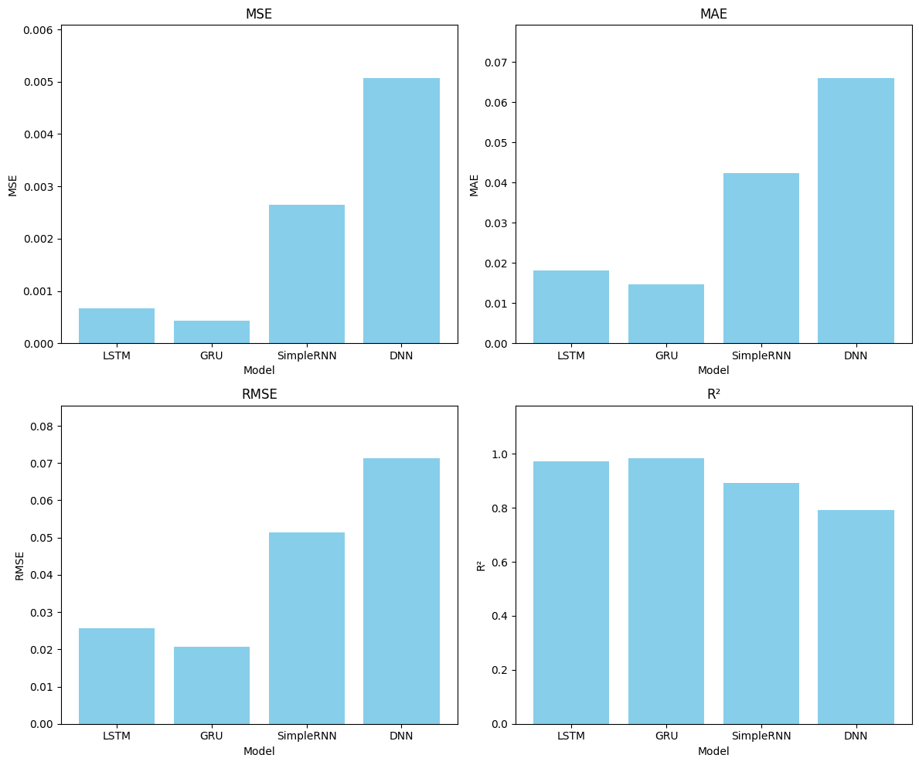
Evaluation metrics

Slide 6
Evaluation metrics
Assessment: Model is evaluated by predicting the closing stock price on the test dataset.
Metrics:
MSE: Measures average squared prediction errors.
MAE: Measures average magnitude of errors.
RMSE: Interprets error in original price scale.
R²: Indicates the proportion of variance explained by the model.
Why this metrics?
RMSE and MSE are especially useful for capturing large errors, which is important for financial predictions where accuracy matters.
R² helps assess how well the model fits the data, indicating the proportion of variability the model explains.
Best Metric: GRU achieved the lowest RMSE and MSE, indicating the least error and best performance.

Slide 7

Results and interpretation
GRU
Best performance with RMSE = 0.02075 and R² = 0.9824.
MSE: 0.00043, indicating low prediction error
Recommendations:
Tune hyperparameters (learning rate, batch size).
Add external features (e.g., earnings reports).
Consider adding more layers to improve accuracy.
Interpretation
GRU captured stock price trends effectively, with high accuracy.

Slide 8
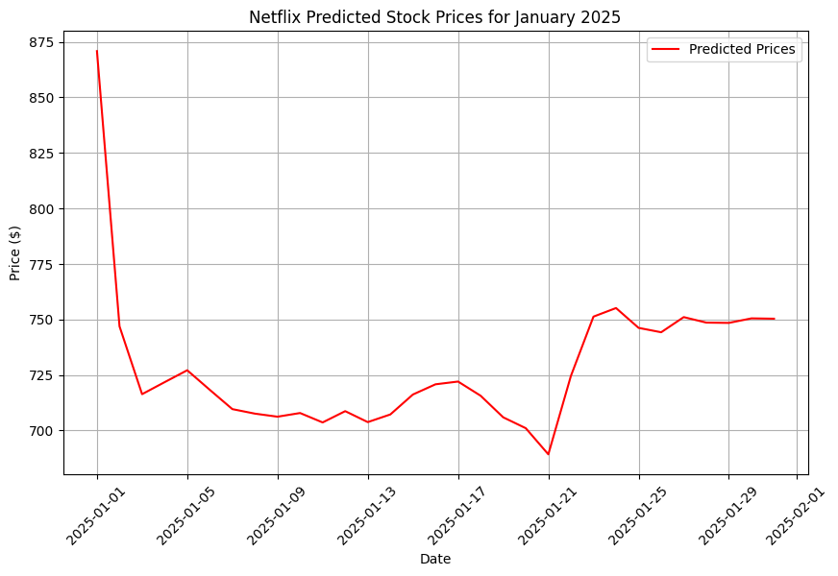
Netflix Stock Prediction for January 2025
Initial High: The predicted price starts at around $875 on January 1.
Sharp Decline: Drops rapidly to approximately $725 within the first 5 days.
Stabilization: Prices hover between $700 and $725 from January 6 to January 20.
Recovery: Around January 21, there was a significant upward trend, which stabilized near $750 by the end of the month.

Slide 9
THANK YOU

